Slide 1
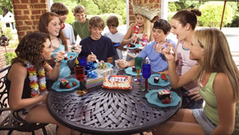
Look at the photo during the preparation period.
Make any notes you wish to on an Additional Answer Sheet.
Your teacher will then ask you questions about the photo and about topics related to me, my family and friends
Your teacher will ask you the following three questions and then two more questions which you have not prepared.
Was gibt es auf dem Foto?
Wie hast du deinen letzten Geburtstag gefeiert?
Wie ist ein guter Freund oder eine gute Freundin?

Slide 2
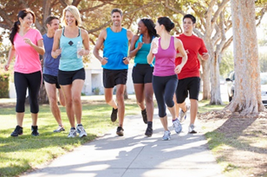
Look at the photo during the preparation period.
Make any notes you wish to on an Additional Answer Sheet.
Your teacher will then ask you questions about the photo and about topics related to social issues
Your teacher will ask you the following three questions and then two more questions which you have not prepared.
Was gibt es auf dem Foto?
Ist es wichtig, fit zu bleiben? … Warum (nicht)?
Hast du gestern gesund gegessen?

Slide 3
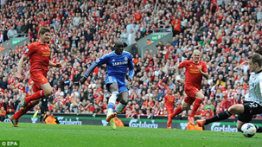
Look at the photo during the preparation period.
Make any notes you wish to on an Additional Answer Sheet.
Your teacher will then ask you questions about the photo and about topics related to free-time activities
Your teacher will ask you the following three questions and then two more questions which you have not prepared
Was gibt es auf dem Foto?
Was ist besser: Sport machen oder Sport ansehen? … Warum?
Wann hast du zum letzten Mal Sport live gesehen?

Slide 4
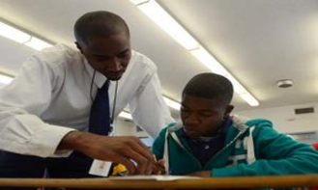
Look at the photo during the preparation period.
Make any notes you wish to on an Additional Answer Sheet.
Your teacher will then ask you questions about the photo and about topics related to my studies
Your teacher will ask you the following three questions and then two more questions which you have not prepared.
Was gibt es auf dem Foto?
Was sind die wichtigsten Schulfächer? … Warum?
Was hast du gestern Abend für die Schule gemacht?

