Slide 1
Glaciated Landscapes
Quick terms test

Slide 2
What is…
A body of ice that’s > 50,000km²?
A glacier that extends into a lowland area from a highland area?
The correct term for loss of ice?
The UK name of the last glacial?
A period of colder climate during a warm phase in an ice age?
The name of the current warm phase?
The name given to variations in the orbit and rotation of the Earth that are thought to cause patterns of climate change?
The name given to the time between about AD1550 and 1850?
The temperature at which ice melts due to force exerted by ice above it?
A tension crack in a glacier called?
A way in which all glaciers move?
The movement of a glacier caused as ice deforms unconsolidated or weaker rock at the bed?
A linear scratch in a rock caused by ice dragging a hard, sharp rock over it?
Notes:
13 marks

Slide 3
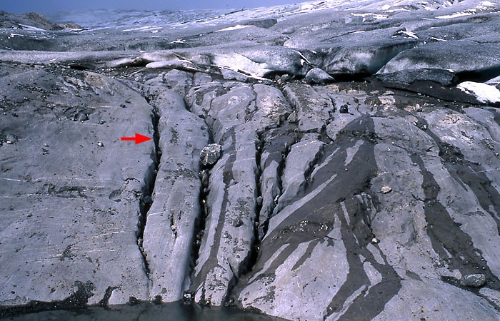
What is…
The arrow pointing to?
Notes:
14 marks

Slide 4
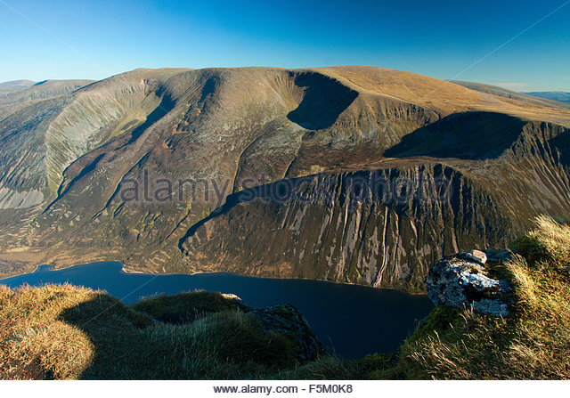
What are…
The landforms labelled A-D?
B
A
D
C
Notes:
18 marks

Slide 5
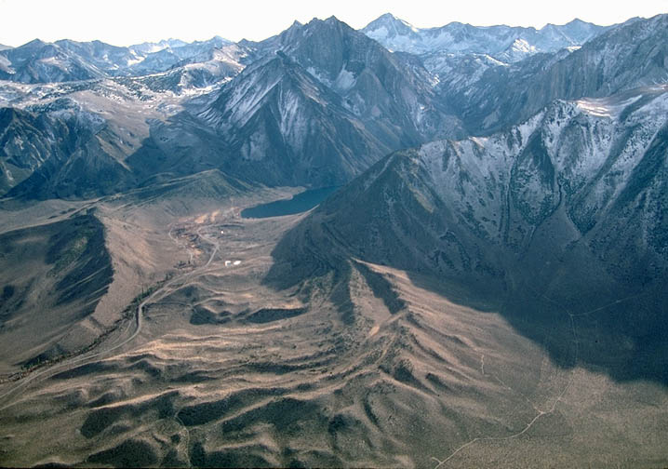
What are…
The features labelled A-D?
D
A
C
B
Notes:
22 marks

Slide 6
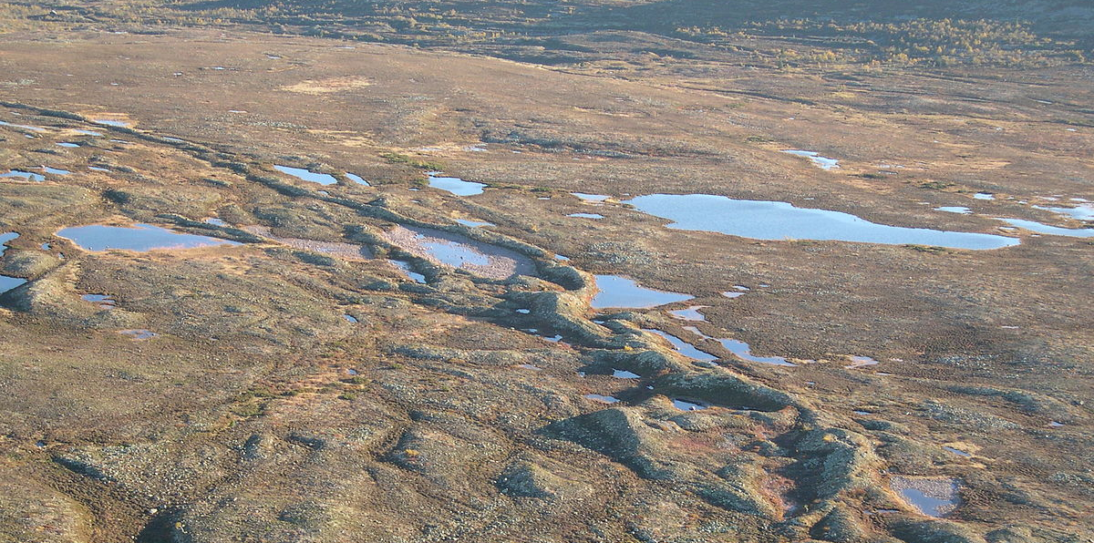
What is…
The arrow pointing to?
The name given to this type of landform?
Notes:
24 marks

Slide 7
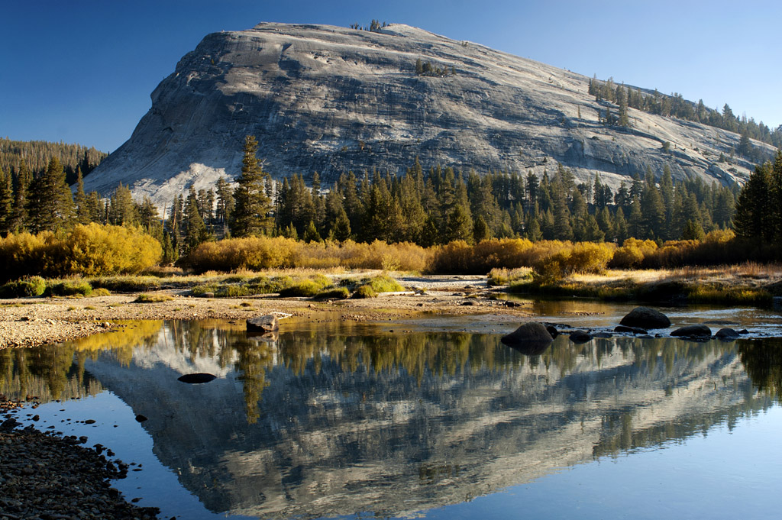
What is…
This landform?
Notes:
25 marks

Slide 8
What is…
The part of the permafrost that freezes and thaws on an annual cycle?
Unfrozen ground in permafrost areas called?
A periglacial slope process?
Notes:
28 marks

Slide 9
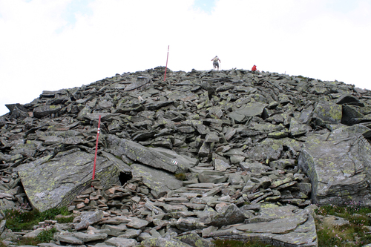
What is…
This a photo of?
The process that has created it?
Notes:
30 marks

Slide 10
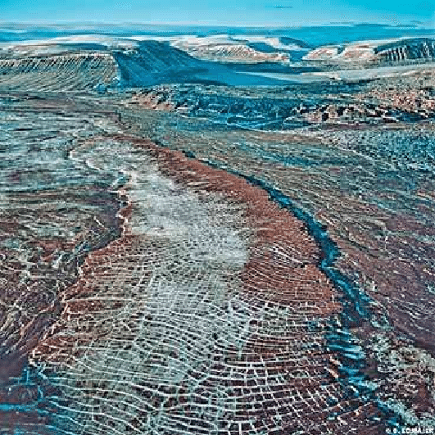
What are…
The periglacial features visible in the foreground?
Notes:
31 marks

Slide 11
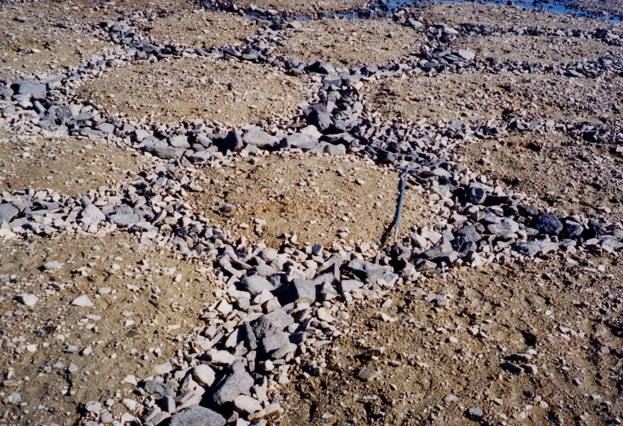
What …
Are the periglacial features seen here?
Process(es) have produced them?
Can you deduce about the gradient of the land here?
Notes:
34 marks

Slide 12
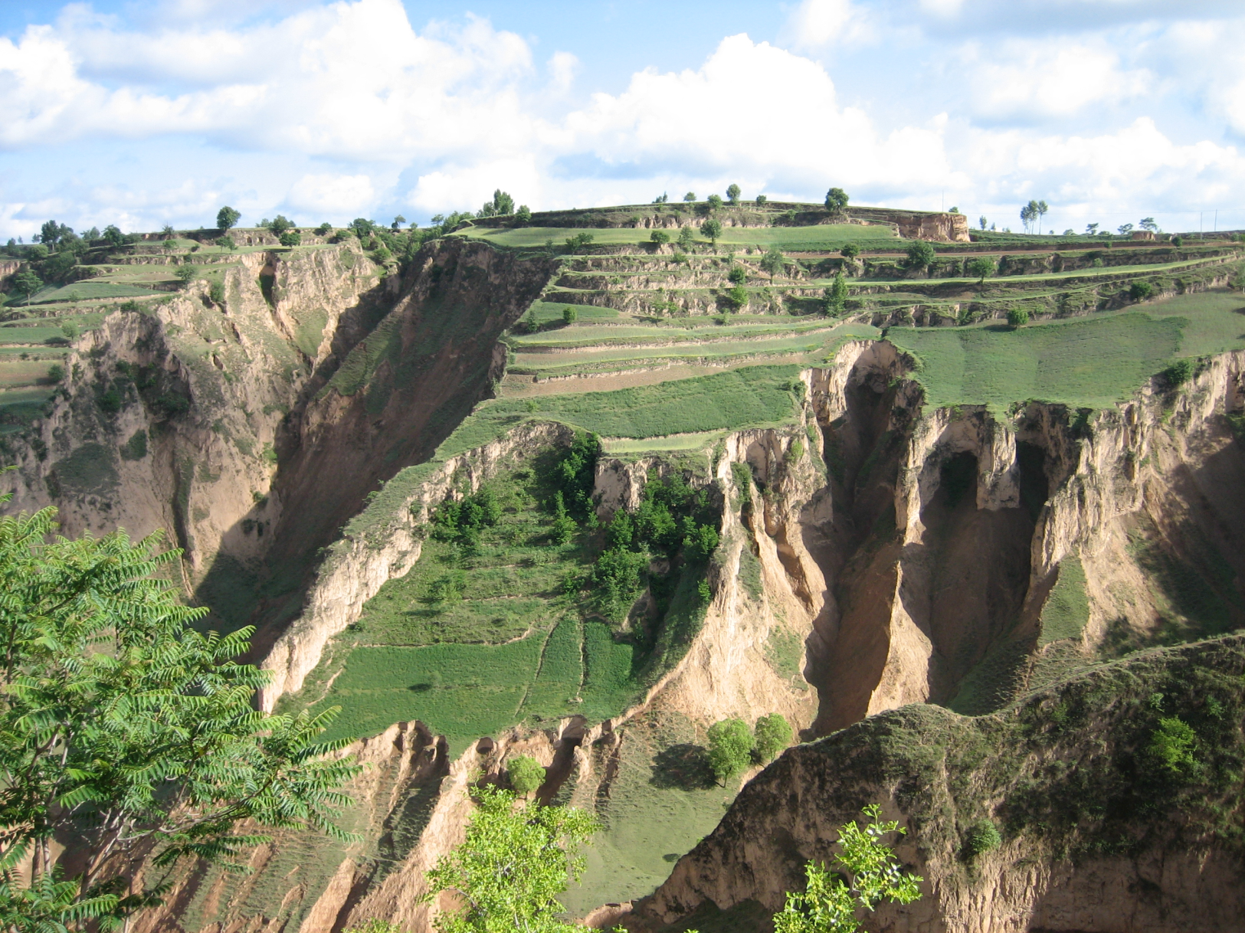
What …
Periglacial material underlies this area?
Caused it to be here?
Notes:
36 marks

Slide 13
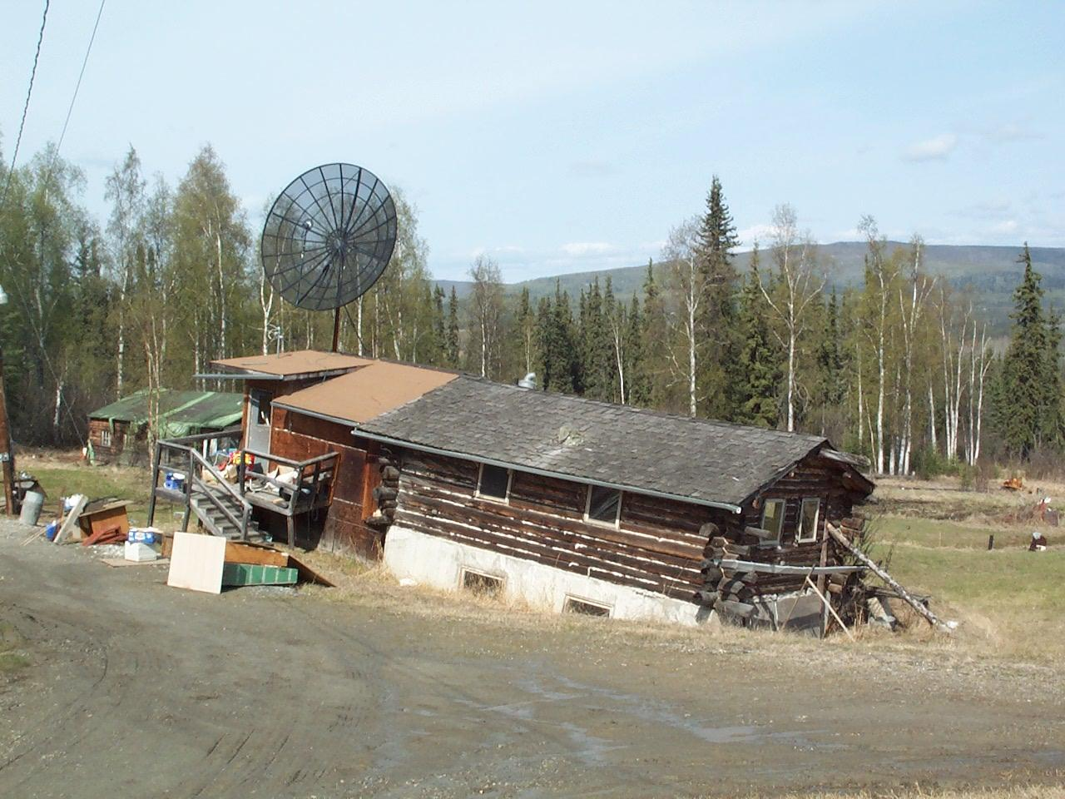
What …
Has caused this house to subside?
Can be done to prevent houses subsiding?
Notes:
38 marks

Slide 14
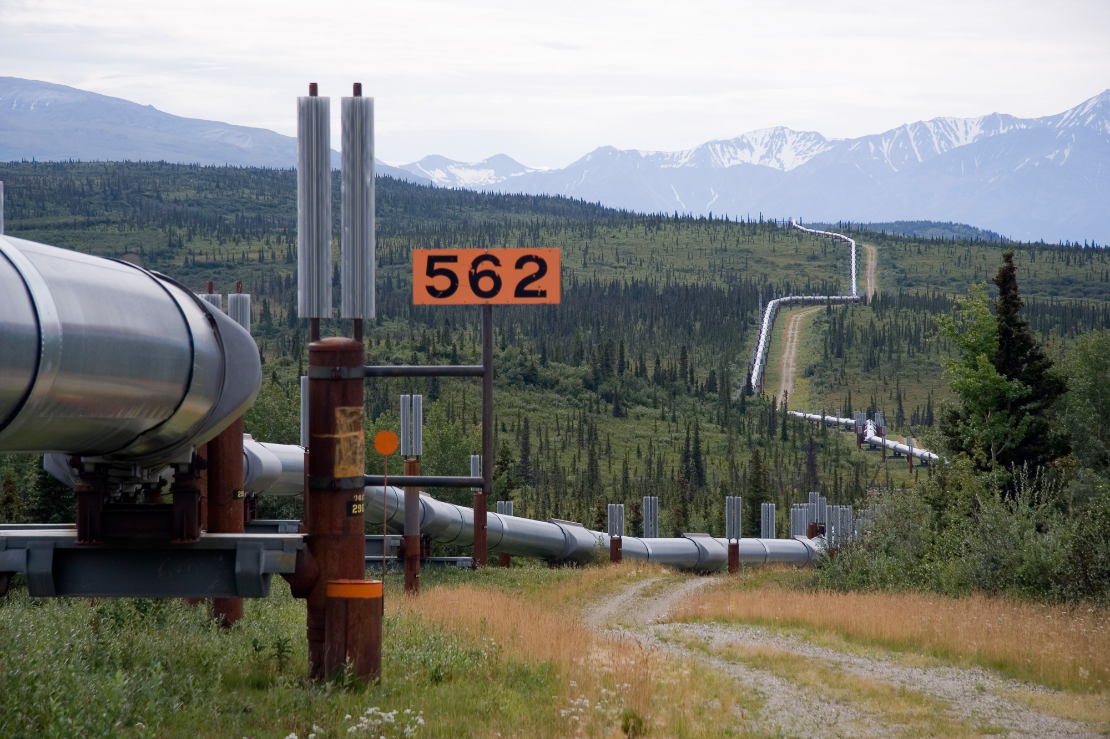
What …
Are two environmental problems of transporting oil across permafrost areas?
Can be done to resolve one of these problems?
Notes:
41 marks

Slide 15
What is…
A GLOF?
One way to manage their impacts?
One way in which human activity can affect glaciated landscapes?
Notes:
44 marks

