Slide 1
Changing Places
Meaning and representation

Slide 2
What you need to know: content
Places are given meaning as a result of people's perceptions, engagement with and attachments to the place in question and are related to different identities, perspectives and experiences, for example the Lake District
Places are represented in a variety of different forms including advertising and promotional material through different media and publications, for example Birmingham Grand Central
Contrasting images portrayed by and between the formal statistical, media and popular images of places
The way in which place meanings have an effect on continuity and change in the nature of places
The way in which these meanings and attachments affect learners own lives and the lives of others

Slide 3
How are places given meaning?
Places are given meaning as a result of people's perceptions, engagement with and attachments to the place in question and are related to different identities, perspectives and experiences, for example the Lake District
Read the handout that has views of residents of Nevada County, California
What are some of the factors that have influenced their view of this place?
What are other factors that can affect what meaning people give to a place?
Notes:
Age, economic status, ethnicity, gender, ideology, language, politics, race, religion, social class, experience…

Slide 4
How are places given meaning?
How do you view the following places? Why do you have these views? To what extent are your views influenced by how they have been represented?

Slide 5
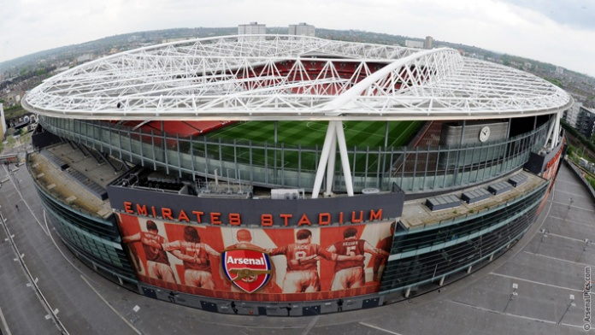
Notes:
Emirates Stadium (Arsenal), North London

Slide 6
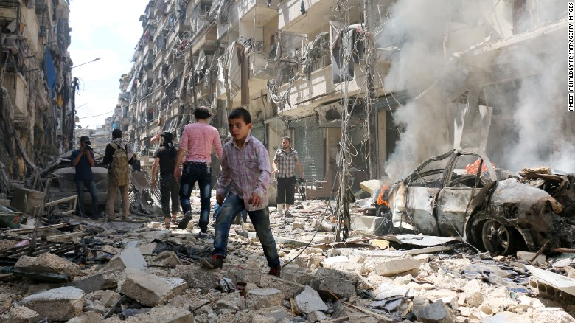
Notes:
Aleppo, Syria, CNN

Slide 7
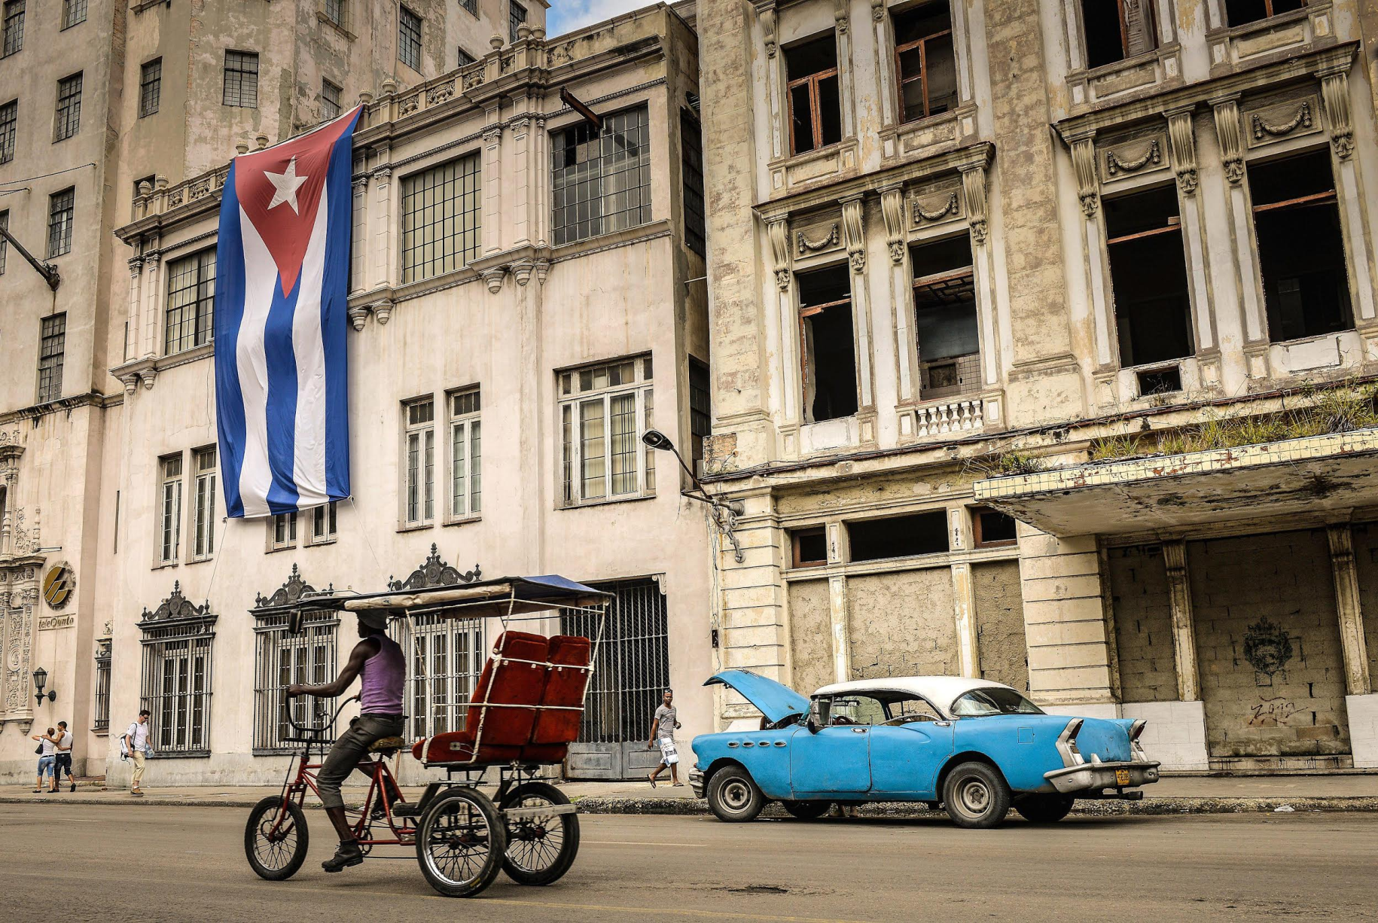
Notes:
Cuba

Slide 8
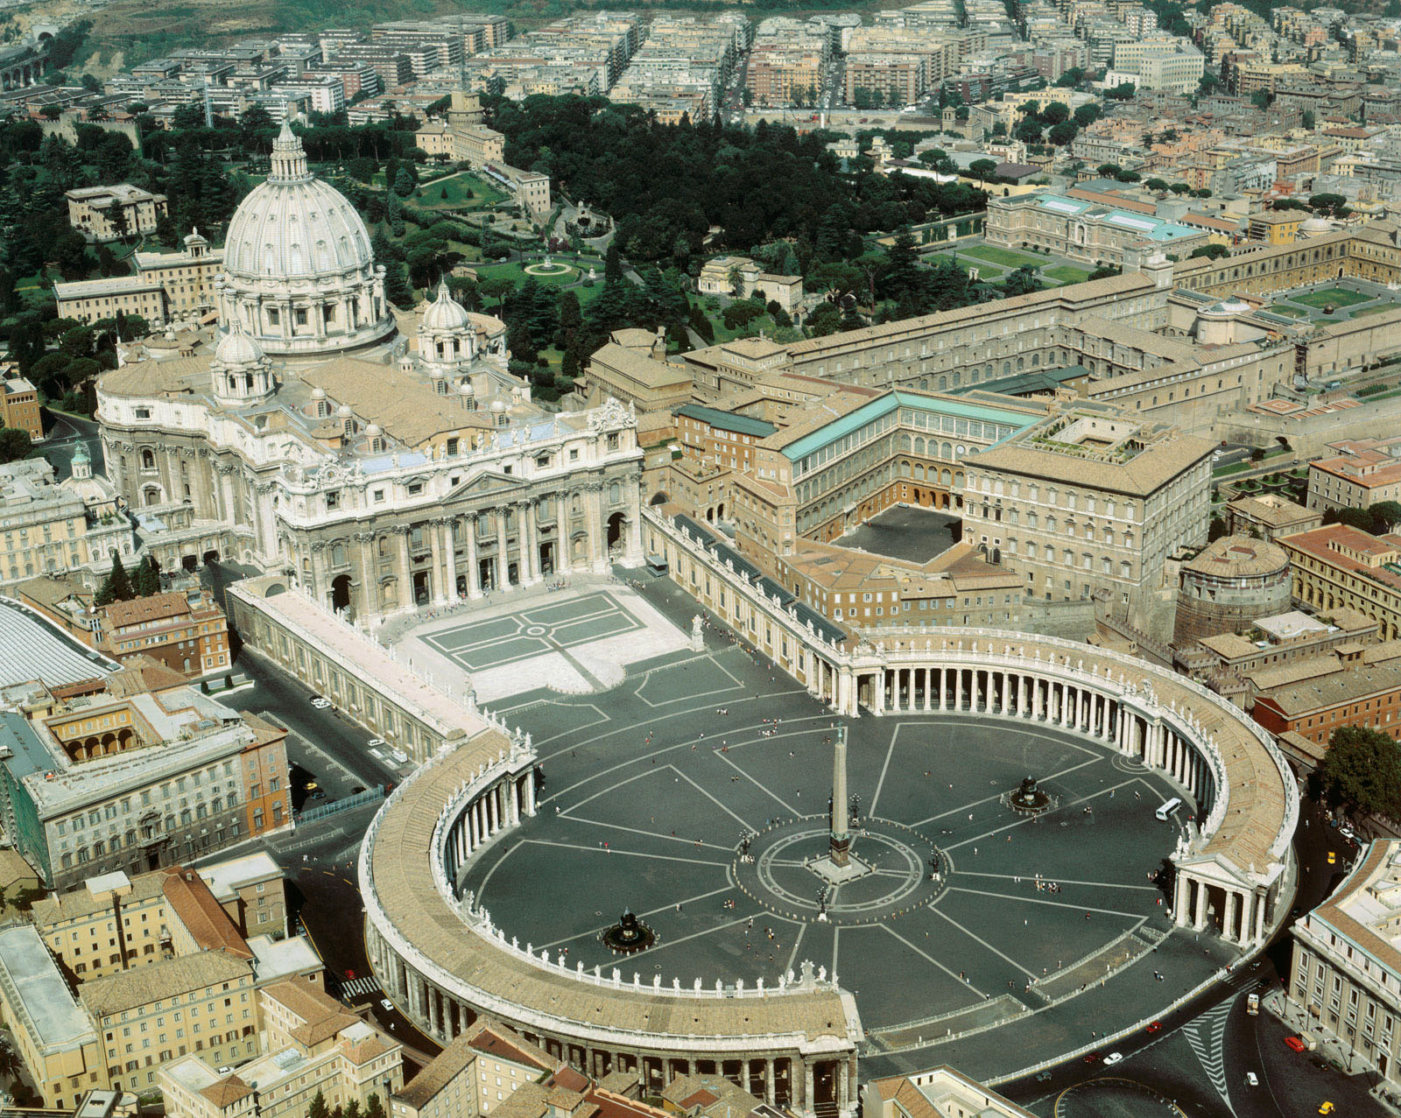
Notes:
St Peter’s Basilica, Vatican City

Slide 9
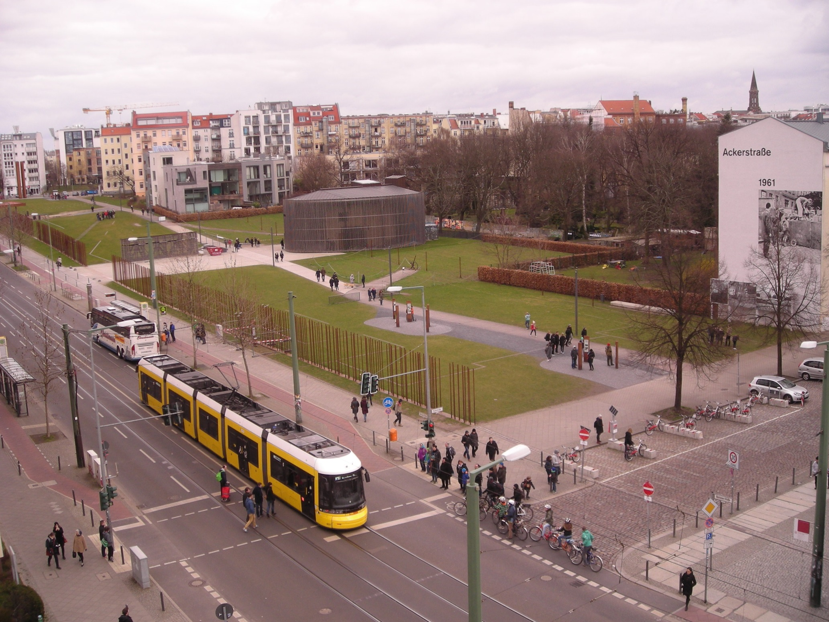
Notes:
Bernauer Strasse, Berlin – Feb 2015 – my photo

Slide 10
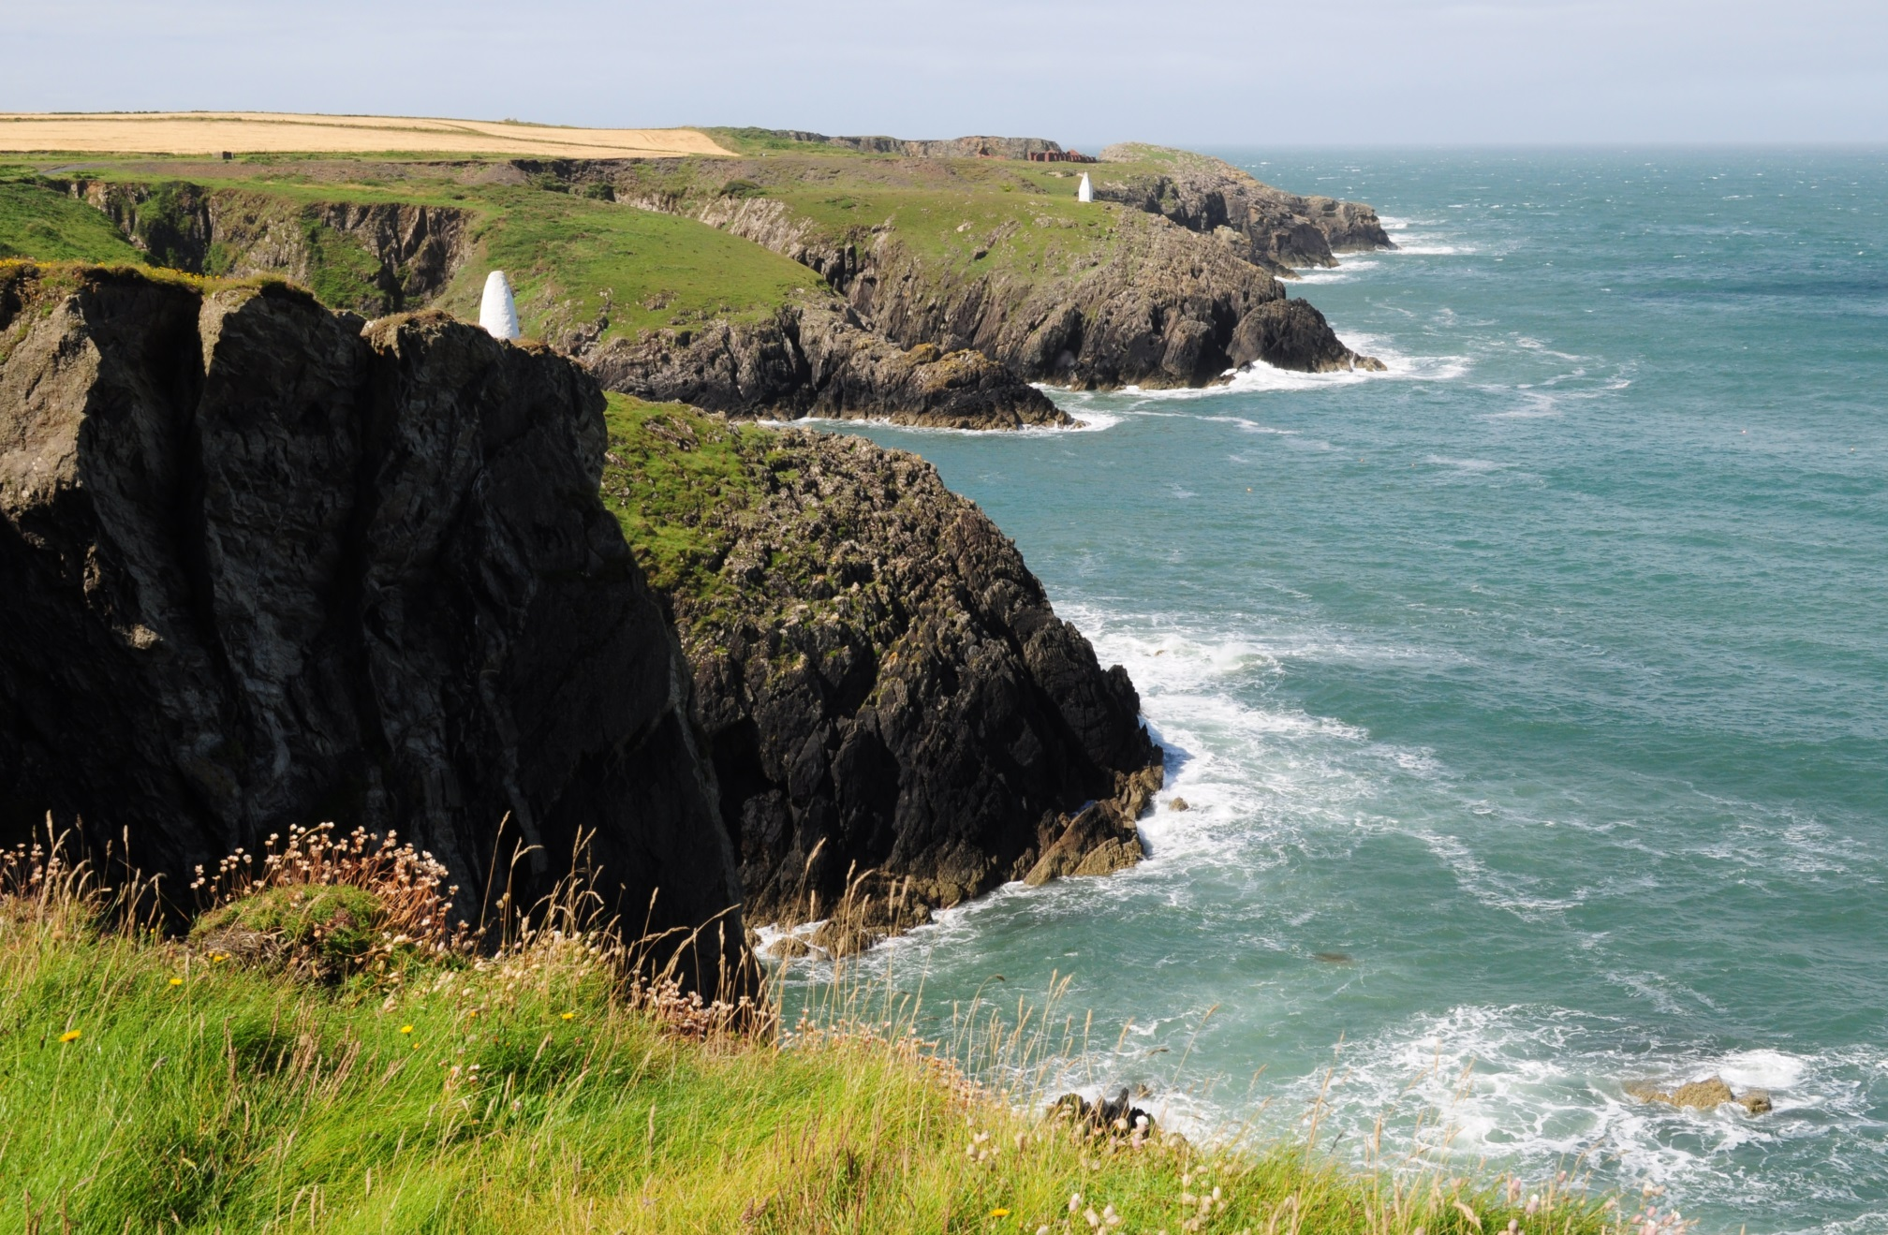
Notes:
Between Porthgain and Abercastle in Pembrokeshire – July 2016 - my photo

Slide 11

Notes:
Ayada Luxury Resort, Maguhdhuvaa Atoll, Maldives

Slide 12

Notes:
Heysham Head – Sept 2012 – my photo

Slide 13
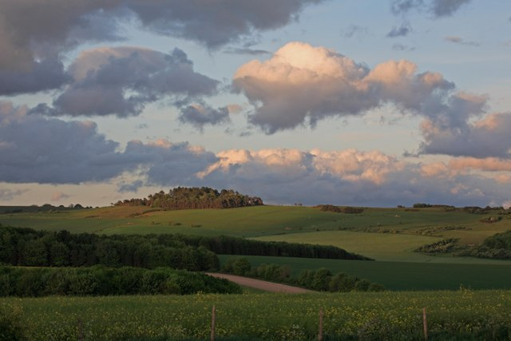
Notes:
Pentridge

Slide 14
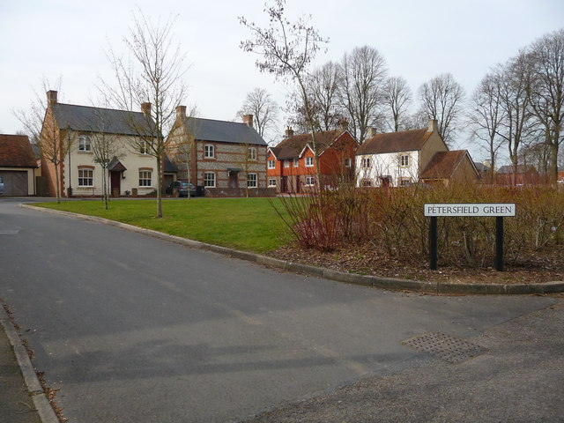
Notes:
Petersfield Green, Tidworth

Slide 15
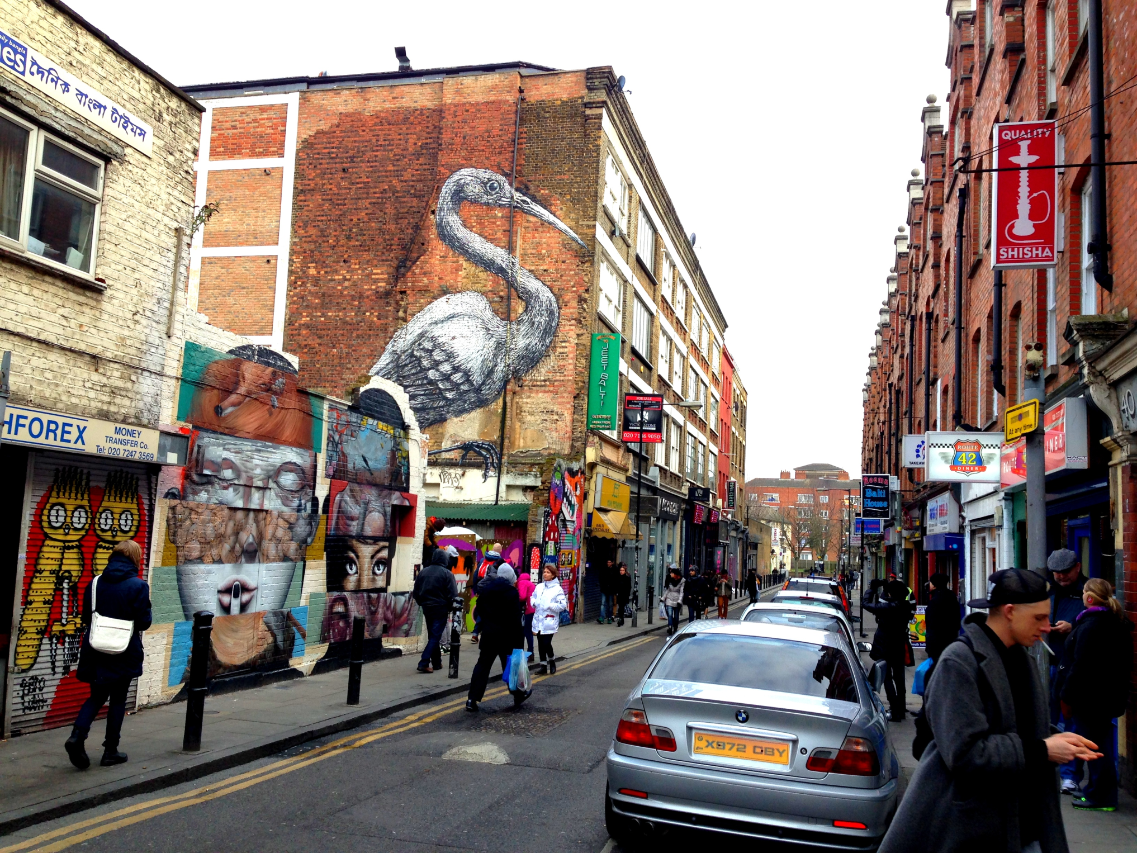
Notes:
Brick Lane, Shoreditch, London

Slide 16
How are places represented?
Places are represented in a variety of different forms including advertising and promotional material through different media and publications, for example Birmingham Grand Central
Contrasting images portrayed by and between the formal statistical, media and popular images of places
List some of the different ways in which places, such as Salisbury, can be portrayed.
What factors might encourage people to have (a) positive or (b) negative views about a place?

Slide 17
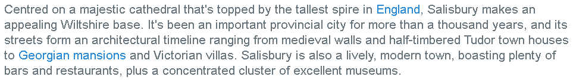
How is Salisbury represented?
How would you describe Salisbury?
Below is the Lonely Planet’s online description:
How is this different from your view? Suggest reasons for your answers.
Find other ways in which Salisbury is presented (you may already have some!). Are any of them negative? [Does Salisbury feature as either a Crap Town or Clone Town, for instance? Do you think it should?] How do these give different impressions about Salisbury? Think about the reasons for your findings.
How is your ‘home’ place represented? How is it given meaning? How do different people view and engage with it? What influences the meaning they have given to this place?

Slide 18
How place meanings affect people and places
The way in which place meanings have an effect on continuity and change in the nature of places
The way in which these meanings and attachments affect learners own lives and the lives of others
Research the redevelopment/refurbishment of Salisbury’s Market Square. Find examples of the different meanings people gave to this place. How did these attachments affect their views… and the final outcome? How does the refurbishment encompass both continuity and change? How do you think the refurbishment has affected people’s lives (how could you find out?) Explain how it has affected you.
Use your findings to write an essay: How place meanings affect people and places
It should be between 500-1000 words and must have specific supporting evidence. Sources of information must be listed at the end. Your answer must demonstrate “your ability to develop a sustained line of reasoning which is coherent, relevant, substantiated and logically structured”.

